Slide 1
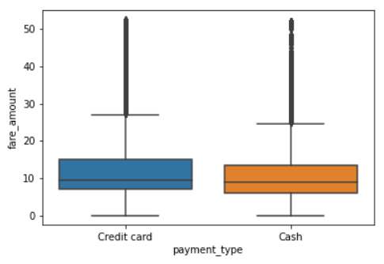
Title: Analysis of the relationship between payment type and fare amount
Subtitle: Do taxi customers pay on average a different fare amount depending on the payment type they use?
Project Overview
The main purpose of this project is to conduct an A/B test to determine whether there is a relationship between the fare amount and type of payment (cash or card) used by riders of taxis in New York City.
The mean fare amount per payment type is the following:
Credit card: $13.43
Cash: $12.21
The following hypotheses were investigated:
H₀: There is no difference in the average fare amount between customers who use credit cards and customers who use cash.
H_{A}: There is a difference in the average fare amount between customers who use credit cards and customers who use cash.
The significance level was set to 5%.
A two-sided t-test was conducted, and the following p-value was obtained: 6.80e-12
As the p-value is smaller than the significance level, the null hypothesis can be rejected. This means there is a statistically significant difference in the average fare amount between customers who use credit cards and customers who use cash.
Distribution of fare amount per payment type, after outliers have been removed.
The difference observed in the available data is likely due to the fact that people tend to not carry much cash on them, therefore fare amounts that are high will tend to be paid for using a credit card rather than cash.
To determine whether payment by credit card should be encouraged in order to increase revenue, we recommend to first conduct a proper experiment where random riders are forced to either pay by credit card or with cash and determine whether the resulting mean fare amount is indeed different.

